Slide 1
Lab 6 Iterator Pattern
Please download the corresponding materials

Slide 2
Before introducing the lab, please pay attention to the following issues:
1, sign in the attendance sheet (20% point deduction for absence);
2, the due (03/07/2018);
3, demo: any labs or office hours before the deadline (redemo is okay); our next lab (03/08/2018) (redemo is not allowed)
4, office hour: Monday 1:00 – 2:00 P.M Tuesday 3:00 – 4:00 P.M
5, submission: push code on Github repo, screenshot of your Github on iLearn
6, introduce: Iterator Pattern, implement based on Composite Pattern (you can use starter code in Github repository)

Slide 3
Iterator Classes
Implement several iterators to fully iterate the composite system ( implement functions defined in “iterator.h” )
Iterator Class – Base Class
Two private data members
Base* self_ptr: root node of the tree
Base* current_ptr: current node it iterates

Slide 4
Iterator Classes
Four functions:
void first(): set the iterator to the start position at beginning
void next(): move the iterator onto next element
bool is_done(): checks whether all elements have been iterated (current_ptr is NULL)
Base* current(): returns the element the iterator is currently at

Slide 5
Other Basic Iterator Classes
OperatorIterator: iterate a composite node with two children
first(): current_ptr points to left child of the node
next(): current_ptr points to right child of the node for the first time, then points to NULL

Slide 6
Other Basic Iterator Classes
2. UnaryIterator: iterate a composite node with one children
first(): current_ptr points to child of the node
next(): current_ptr points to NULL

Slide 7
Other Basic Iterator Classes
3. NullIterator: iterate a leaf node
first(): current_ptr points to NULL
next(): current_ptr points to NULL

Slide 8
Other Basic Iterator Classes
4. “composite.cpp” adds two extra functions in each child class of Base
Iterator* create_iterator(): returns a relevant iterator for each child class of Base
print(): print operator for Add, Sub, Mul, Div, Sqr, print value for Op

Slide 9
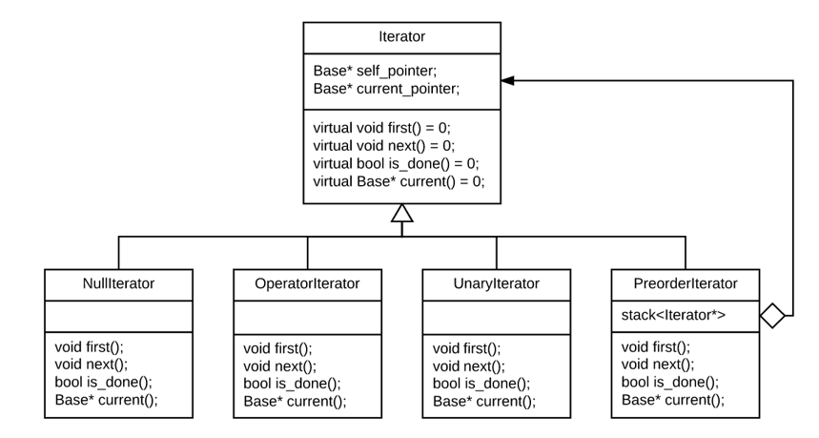
UML

Slide 10
Preorder Iterator Class
visit Base* tree in preorder
Important data structure:
stack<Iterator*> iterators; //create an iterator for each node, use stack to manage them during traversing period

Slide 11
Preorder Iterator Class
output
stack
current_ptr
R
*
*
2
3
UnaryIterator (self_ptr
current_ptr)

Slide 12
Preorder Iterator Class
output
stack
current_ptr
R
* 2
*
OperatorIterator
(self_ptr
current_ptr)
2
3
UnaryIterator (self_ptr
current_ptr)

Slide 13
Preorder Iterator Class
output
stack
current_ptr
R
* 2
NullIterator
(self_ptr
current_ptr = NULL)
*
OperatorIterator
(self_ptr
current_ptr)
2
3
UnaryIterator (self_ptr
current_ptr)

Slide 14
Preorder Iterator Class
output
stack
current_ptr
R
* 2 3
*
OperatorIterator
(self_ptr
current_ptr)
2
3
UnaryIterator (self_ptr
current_ptr)

Slide 15
Preorder Iterator Class
output
stack
current_ptr
R
* 2 3
NullIterator
(self_ptr
current_ptr = NULL)
*
OperatorIterator
(self_ptr
current_ptr)
2
3
UnaryIterator (self_ptr
current_ptr)

Slide 16
Preorder Iterator Class
output
stack
current_ptr
R
* 2 3
*
OperatorIterator
(self_ptr
current_ptr = NULL)
2
3
UnaryIterator (self_ptr
current_ptr)

Slide 17
Preorder Iterator Class
output
stack
current_ptr
R
* 2 3
*
2
3
UnaryIterator (self_ptr
current_ptr = NULL)

Slide 18
Preorder Iterator Class
output
stack
current_ptr
R
* 2 3
*
Done!
2
3

Slide 19
Testing
Since there are starter codes in your Github repository, you only need to implement “iterator.h” and “iterator.cpp”
You don’t need to change “test.cpp”
Output Result for example in “test.cpp”: - + 3 4 ^2 2

